Slide 1
Opening Sequences Analyses 1-5
George Nutt
Deconstructing film opening sequences

Slide 2
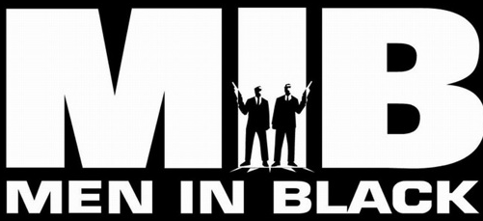
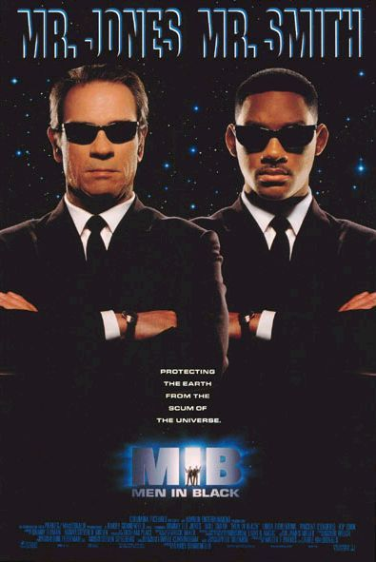
Men In Black
Link to video
The dragonfly is a bright green colour which stands out in the dark blackish setting. Also green relates to the colour of aliens and mystery which matches the film.
The lighting throughout the film is very low key and dark as it is at night.
The camera begins in space displaying how it is going to be a sci-fi genre of film with aliens since they live in space.
The camera follows the dragonfly throughout the whole sequence and is continuous showing its back and front.
The non-diegetic sound is long a varies to do with what is happening to the dragonfly such as at the start it shows a close up of the dragonfly looking intimidating and the music gets loud and lower pitched, then when it switches to a high angle shot, the music changes to lighter and higher pitch.
During the end before it is close to getting hit, the music picks up and becomes more intense.
Then when it is hit there is the pleonastic splatter sound effect that emphasises how small it actually is, contradicting before when it seemed intimidating and big.
The camera pans down from space to earth like an alien would come down to earth. There are special effects used to create the dragonfly.
The font is thin and has a white glow which causes it to be similar to the stars in space and also it would portray mystery.

Slide 3
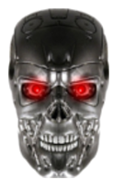
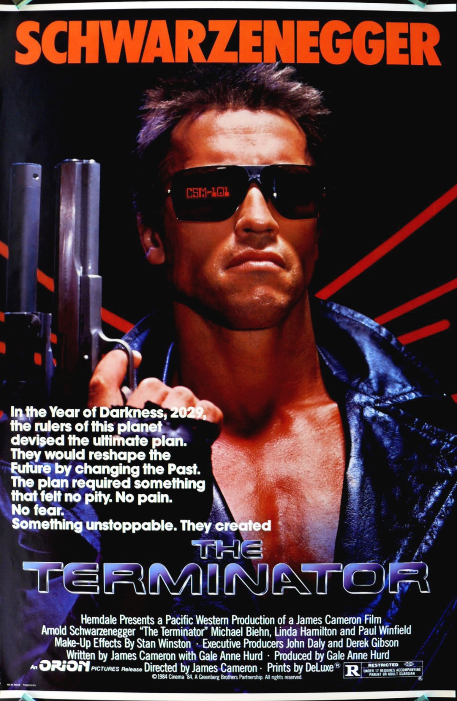
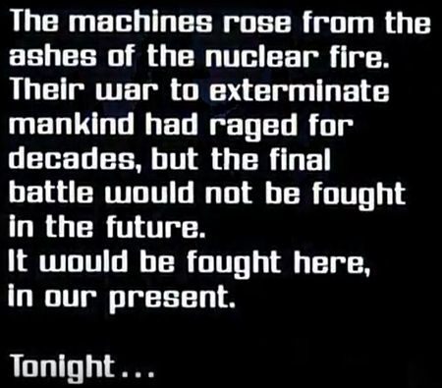
The Terminator
Link to video
It begins with a destroyed sort of setting and an action sequence to catch the viewers attention.
There is pleonastic sound of the bullets of the futuristic type guns being used, this shows us what type of genre its going to be before they watch it; action adventure sci-fi. The bullets from the guns are created using CGI and special effects, this is what I could do with my title sequence.
It has a blue tint showing its cold and also gives it a sci-fi robots feel. The lasers from the guns also are blue so this is showing the audience that the film is going to have a main colour of blue throughout the film and this is also the only colour other than black in the title sequence.
There is also a cliff-hanger at the end before the titles roll and it makes the audience wonder what is going to happen and also tell us what the plot of the film is going to be. It then fades to the titles.
It then shows the titles and the font of them all
look as though they are being typed by a computer
giving it a sci-fi theme and make it so you know it is
about robots.
Also the font is sans-serif, square and computerised.
The non diegetic music is also mysterious and sounds
very computer-generated at points adding to the sci-fi
effect.
The camera pans to give an overview of the
destroyed area at the start.

Slide 4

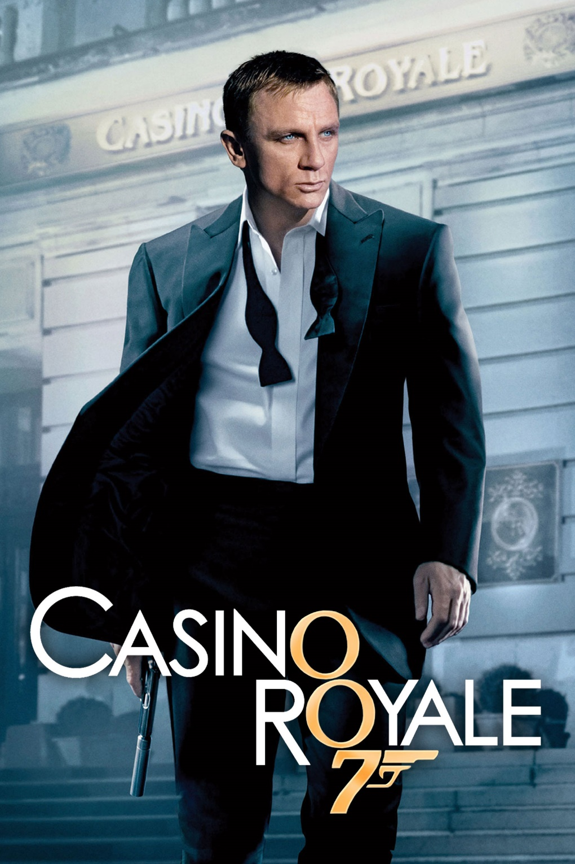
Casino Royale
The main two colours throughout the sequence are
black and red as the films title is ‘Casino Royale’ and the colours on the cards are black and white, they also represent the bad and good with black as the spy (the good guy) and red, the villain. It all follows the house style of the film.
It has style that strongly relates to the title and theme with cards flying everywhere and most things either black and red or yellow and it also has the logos of the four cards acting as different things such as bullets
It transitions through simple cuts a lot and many of the scenes are of people fighting or falling giving us an idea of what the film is going to be like.
The camera often moves in slow motion and at the start it zooms away from Daniel Craig and at the end you see a close up of his face which is real so he stands out from the edited background and film.
The accompanying music is loud and intense throughout the whole thing and it matches the fight sequences and the tragedies happening in the titles.
There are a lot of props of guns. There are also fights and death to show us what the film is going to be like and would intrigue the audience. Also there are a lot of special effects used throughout the whole thing to animate people and give them assigned colours with the antagonist being red.
The font is formal and fits in with the film as it is also formal with people in suit and spy's, the font is also sans serif.
Link to video

Slide 5

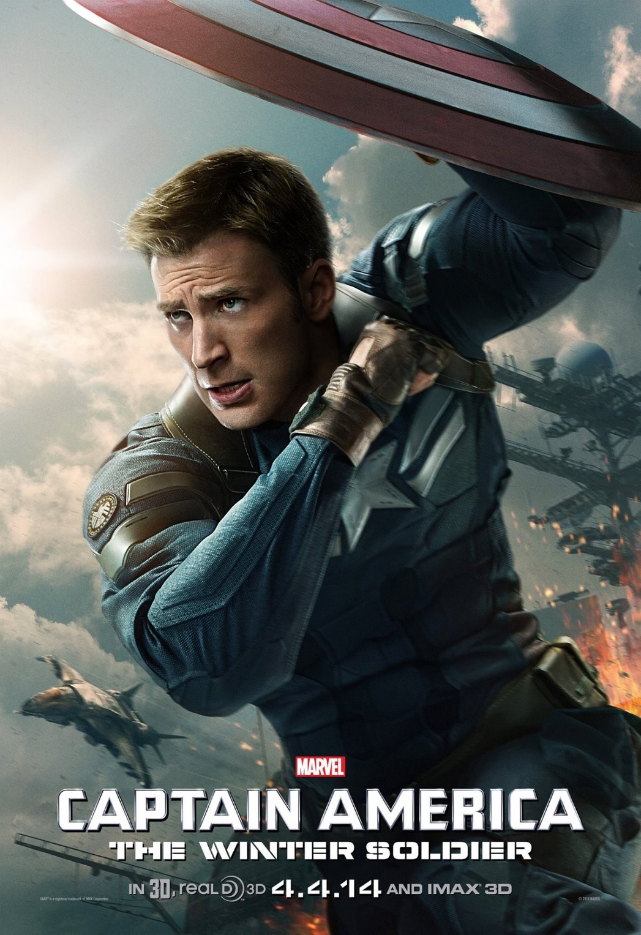
Captain America:
The Winter Soldier
Link to video
The titles are a formal sans-serif font placed on a certain position on the page that has a blank background so it is easily seen.
The colour of the titles are mainly black and white but then has the colour of red on certain parts, red is the main colour of his shield. It stands out a lot against the background and is used to emphasise his shield then the colours are flipped later on.
The style is very clean and organised which could be describing how he is when he does his work.
The transitions from one shot to another has very smooth cuts and is done so that when one thing happens it lead do another thing such as the shield smashing into the screen leading to the next shot.
The camera shows long shots of captain America to show the action of what he is doing. It is often a still image that shows us what he is doing.
The use of silhouettes that are edited in with special effects for everyone is so that you can not see if people are antagonists or protagonists and you cannot see their actual identity which doesn’t spoil anything for the film which is something I could consider for my opening credits. The silhouettes are all made with special effects where they film a person and put a black overlay over them and I could use techniques the same or similar to this when making mine.
The accompanying music in the background is very patriotic and heroic to emphasise the character of Captain America being a superhero and also that he is an American citizen and is proud of it, this will appeal to its audience; mainly American people. The music is also tense which gives us a glimpse of what the soundtrack later will be.

Slide 6

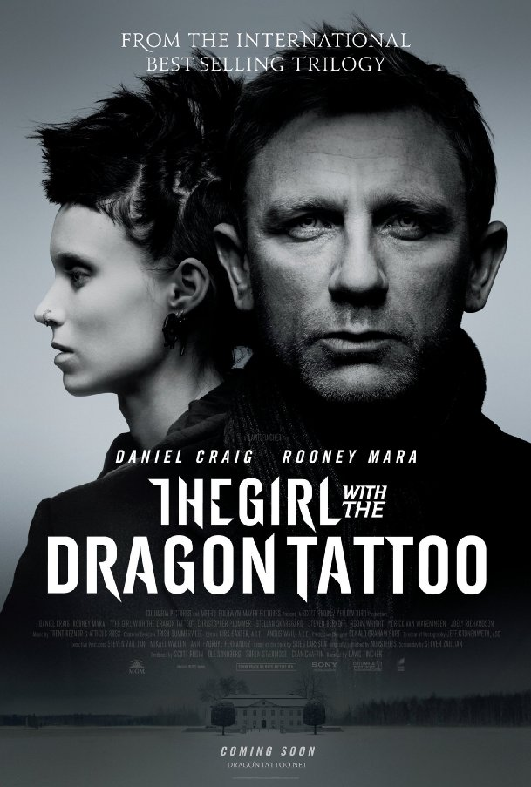
The Girl with the Dragon Tattoo
Link to video
The colour is very desaturated and dark with just using the colours of black and grey, this seems to be the style for the film with the poster being the same sort of tone. This shows how the film is going to be dark and not a happy film. The only colour in it is the orange fire which is to emphasise it and its destruction.
The style of the font is serif as it has many different decorative ‘feet’ coming off of the letters, these feet are very pointy and they are a similar style to the tattoo and it gives and Asian feel to it with dragons because of Chinese dragons, this gives us an idea of where the location is.
The transitions are fast paced cuts showing how the film will include action.
The movement is fast and shows us glimpses of dark and out of the ordinary things happening throughout, this could be to show us how the film is going to be out of the ordinary and dark.
There are a lot of special effects and CGI in this. First of all editing colour tone to make everything the same sort of greyish tone and to make the flames stand out. Also there are effects to make it look like everything is made of a sort of liquid metal and it is taking over everything and causing destruction.
The non diegetic accompanying music has an aggressive tone with the instruments all the way throughout showing us how the film will be similar.

