Slide 1
Opening Sequences Analyses 6-10
George Nutt
Deconstructing film opening sequences

Slide 2
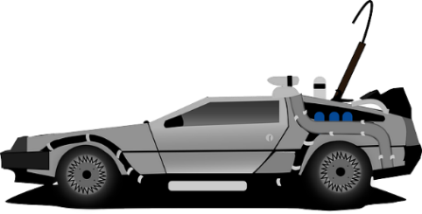
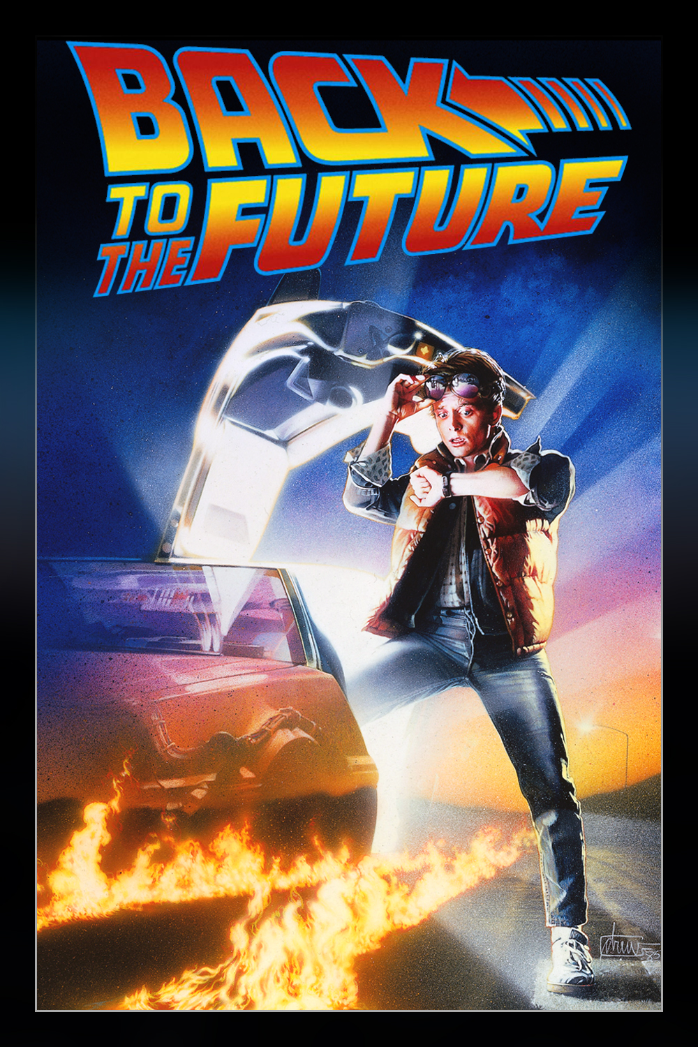
Back To Future
Link to video
The colour throughout the sequence is very bland and the colour of brown and very old objects such as clocks, also with black and white photographs as well. This shows something to do with the year it is set.
The style is very dated. Despite this it also flows well and uses contraptions that are clearly made by someone very smart, creative and into science; showing the sci-fi genre of the film. Also the old style implies the person is also old so the style gives us a good idea of the type of film.
The transition and movement of the camera is flowing and continuous throughout, showing the whole contraption that has been made as well, and since there are so many clock the person is clearly interested in time and therefore this is a theme of the film
Also the camera first shows a mid shot of a news programme talking about a problem with stolen plutonium then the camera follows a skateboard into a box of the plutonium mentioned earlier.
There is no CGI used, just the filming of clocks and a contraption showing how it was made from nothing from some sort of genius or talented person.
The accompanying sound in the background is no music but just the diegetic constant sound of the clocks emphasising the theme and ideology of time.
This helps my planning as it shows that original different sequences can be the best sequences.

Slide 3

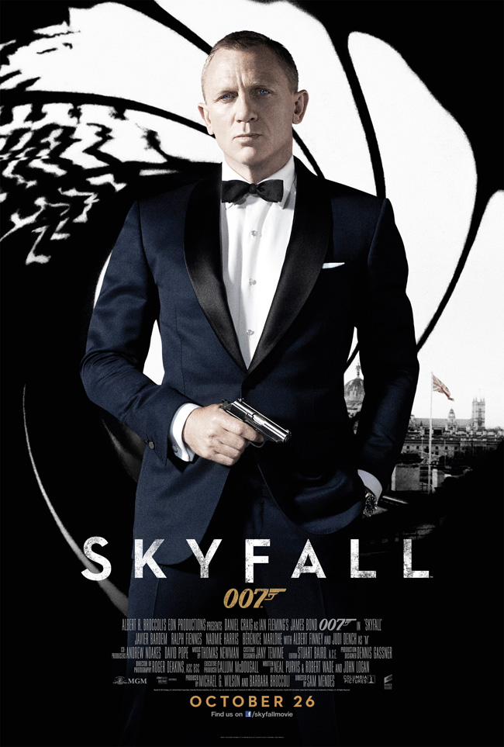
SkyFall
Link to video
The main colour it starts with is a light blue showing calmness and tranquillity which also matches the tune and flow of the song and transitions which are smooth and continuous. Also the colours of black and red are included; the red for symbolising blood and death and the black to show the antagonists.
The style of the text is very formal and square to match the genre of the film which is the spy genre, this includes things such as the suit as well as throught out, organised plans.
The transitions are continuous throughout the sequence and all of the time it consists of going forwards through a small gap which could be representing how he will carry on even though its hard. Also it transitions through many different settings such as graveyards and a Chinatown type place with the Chinese dragon, this shows the locations he could possibly travel to in the film including the graveyard possibly foreshadowing a death.
The movement is slow and under water and calm as if it was commemorating a death since we do not know if James Bond has been killed or not yet.
There are effects that are made with editing and CGI such as the hand pulling him down through a whole or when there are loads of Chinese dragons flying around and then one breathes into a close up of the camera and this then leads to a transition of fire which links to the next part of the sequence. There is also a part where he is shooting shadows and this shows how the antagonists are perceptive and minor.
The non diegetic accompanying music is calm and emotional as it links in with his possible death and if he did die then thins would be commemorating him.

Slide 4
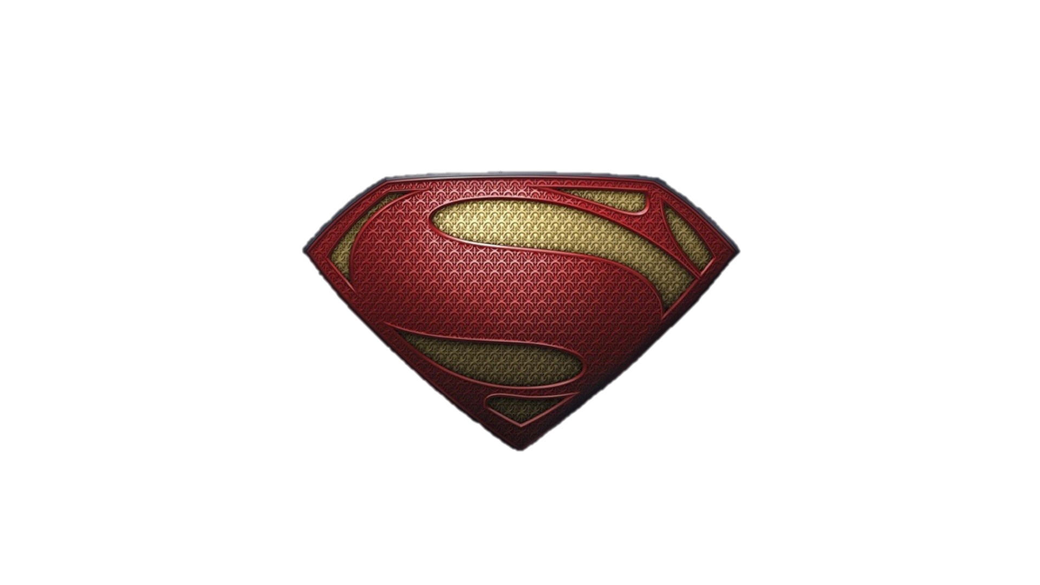
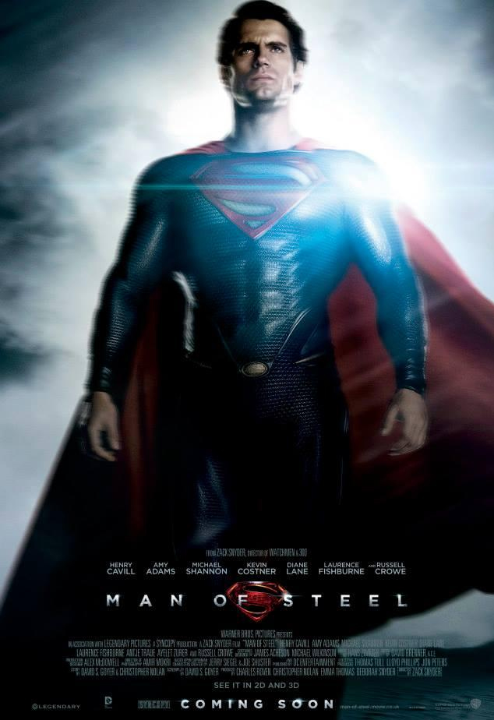
Man Of Steel
Link to video
It starts in space which is common in films showing that something has come from outer space, so if I was to do a sci-fi film to do with outer space then this could be an idea for it.
The font is thin and white showing how it is similar to a star in space because its small and white so this represents space, similar to men in black which I previously analysed which started off in space as well, however the font on this is more straight and formal showing that he is a superhero and his work is well thought out and formal.
There is a slight bluish grey tint when showing the city and outer space this is to emphasise his superman's bluish grey costume and style throughout the whole film. This is what I could do in mine, I could give the film a thematic colour then give the sequence a similar colour tint.
It is a very calm style and atmosphere throughout and shows the story of superman's life using transitions that all work together showing through the years of his life in a short amount of time and summarising it all in two minutes so they know what going on for the film.
There is movement of the camera slowly panning over landscapes to induce harmony

Slide 5
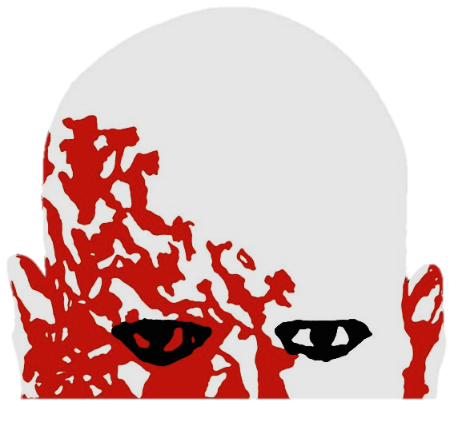
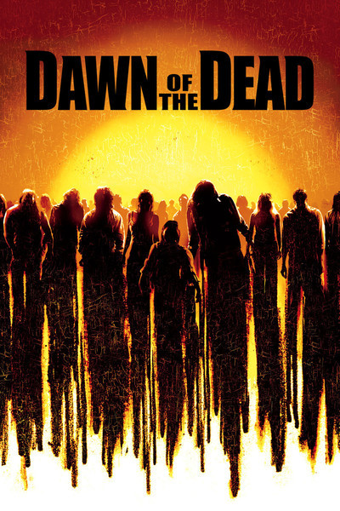
Dawn of the Dead
(2004)
Link to video
The font is a very bold red font which is simple and big and stands out with the blank black background.
The colour of the titles are black and red and within the short videos black and red are also used colours as they are both colours that are dark and to do with death and blood.
It has a clear horror style with the fast paced cuts showing glimpses of zombies and old news reports showing people worried, scared and devastated, this fits with the genre of film which is horror.
The transitions of the font as it goes to the next cut is it liquefies and turns to blood that is wiped of the screen which gives the titles a much more interesting effect. Also there are very fast cuts that show only a second of the film leaving the audience disorientated, confused and wondering what is going on.
The movement of the camera is quick and shows how everything is confused and rushed and everyone is panicking. Also it shows shots of things such as microorganisms showing us that it was probably caused by some sort of a disease.
There are diegetic sound effects of people screaming and panic and there is also special effects make-up used for the zombies and the blood. This is what I could use if I was going to do a horror genre however I am not so I could use this for an idea and I could use special effects makeup for something else.
The non diegetic accompanying music sounds happy which is In contrast to what is actually going on which could be showing how the government are trying to cover it up in the film. Although the lyrics actually describe the horror that is going on.

Slide 6
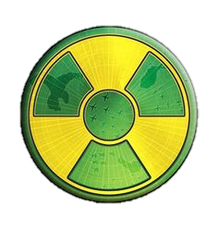
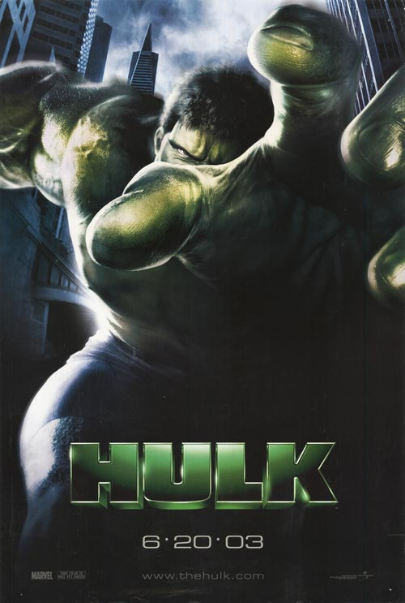
Link to video
Hulk
(2003)
There is a clear green tint throughout as this is the colour of the Hulk and is therefore it is then thematic colour and this tells me when I come to doing my own I should create a colour. This colour is linked with radioactivity which relates to the story as it was how he was created.
The font for the titles has a bright green colour and it is also an original font with an unusual shape which conveys the film. The font of the actual title saying ‘HULK’ is different as it is bulky and a very straight sans-serif font which is represents the Hulk itself.
At the start the transitions follow an organism and also a galaxy, this is showing us that the theme of the film Is going to be science and it will have something to do with experiments.
There is a canted angle close up of a man faded out near the end showing his expression showing no sympathy towards the monkey he has just injected, this give us the impression of him being an antagonist in the film.
There are special effects when it comes to the titles at the start as they are moving across in the location of space which couldn’t have actually been done. Also there are special effects used to create a transition that is the text exploding into stars.
The non diegetic accompanying music quietly intensifies throughout the sequence.

