Slide 1
Opening Sequences Analyses 16-20
George Nutt
Deconstructing film opening sequences

Slide 2
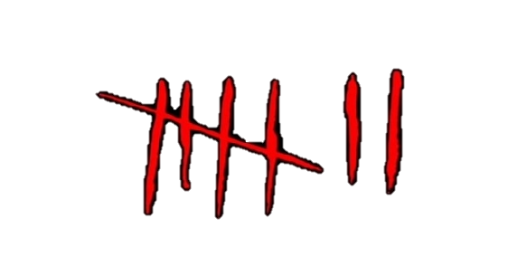
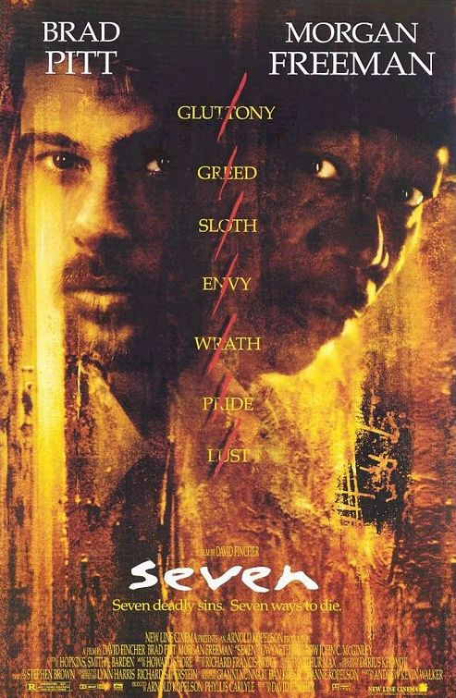
Se7en
Link to video
The font used for the titles is thin and they look like they are written, however the editing is used to make it fit with the genre as it makes them do things they aren’t supposed to such as move or have a ghost effect on them.
It is also positioned in each shot so that it is either out the way or on it has a black screen for the background, this therefore makes it always visible.
There is a lot of low key lighting showing and the non diegetic sound of the music is also dark and spooky and includes noises such as creaking doors and noises that sound like people screaming, this gives us a clear idea of the genre which is horror.
There are sometimes fast paced cuts that only show small glimpses of certain props (e.g. razors which show violence and horror) and events too make it more mysterious and obscure.
There are transitions of fading to black a lot of the time.
There isn’t a shot of a humans face, just an extreme close up of one persons hand shown over and over, meaning that he is staying hidden so the character cannot be stereotyped by his looks straight away because all you see is his hands this creates curiosity and mystery.
The production company is put into the sequence with a different font to the other titles as this makes it stand out and people know it is not the main titles as it is the production company.

Slide 3

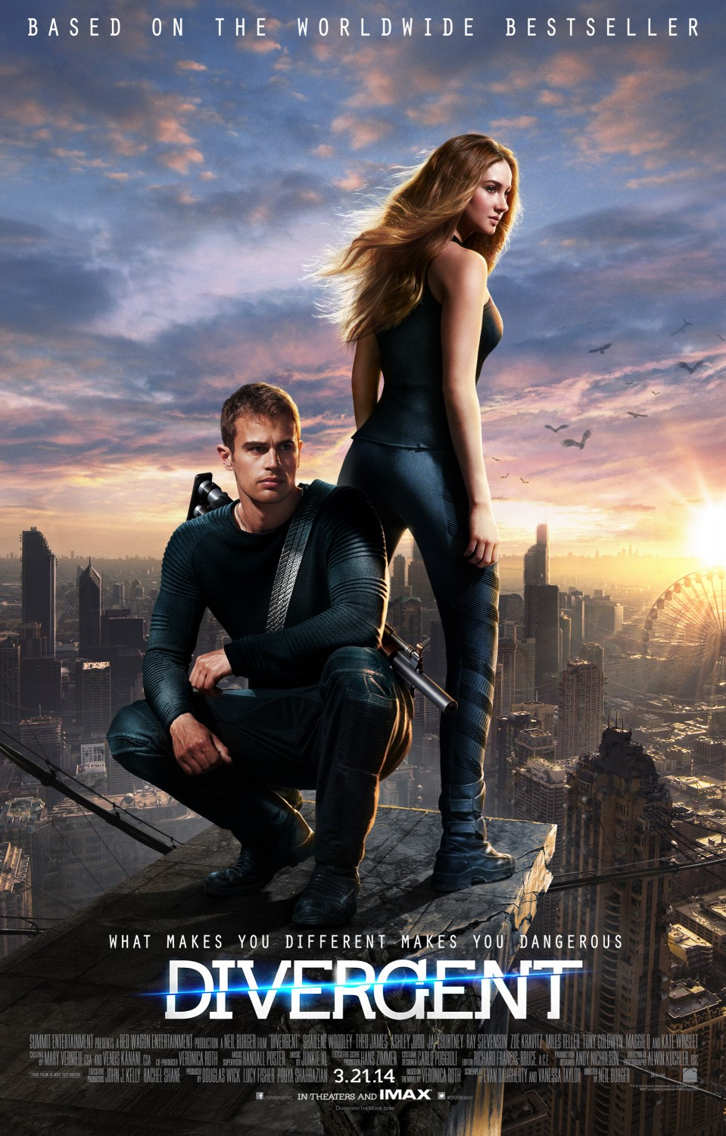
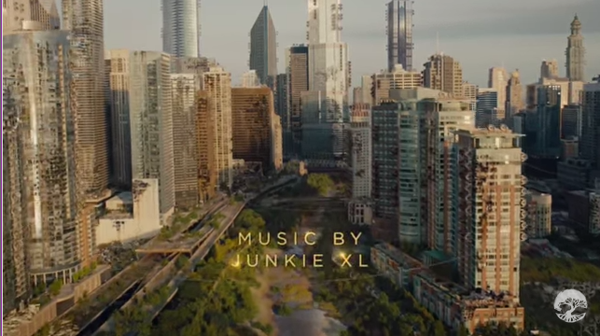
Divergent
Link to video
Starts off by showing the production company in the house style colour of the film and leaving it on the screen for a few seconds to make sure it is seen.
The movement throughout is very slow and calm and the accompanying music is very calm and harmonic, this could be because the film is about a girl who are stereotypically represented as quiet, timid and weak in film.
The camera starts off with a slow pan that shows an empty field with birds quietly tweeting, this adds to the harmonious effect.
The font is thin and gold which matches with the song at the start, the font is also formal and straight giving us an idea of what the film is going to be like.
The titles are positioned in certain places so that they are out of the way e.g. , the buildings are still visible and not cut off
Because of the mise en scene there are clear separations between people as they are all in groups and all have the
same colour clothing, so this shows us there
is probably some kind of system where
people are separated.
There is a high angle shot of all of the people
showing them as small and vulnerable and
in the film there is something probably
controlling them such as the government.

Slide 4
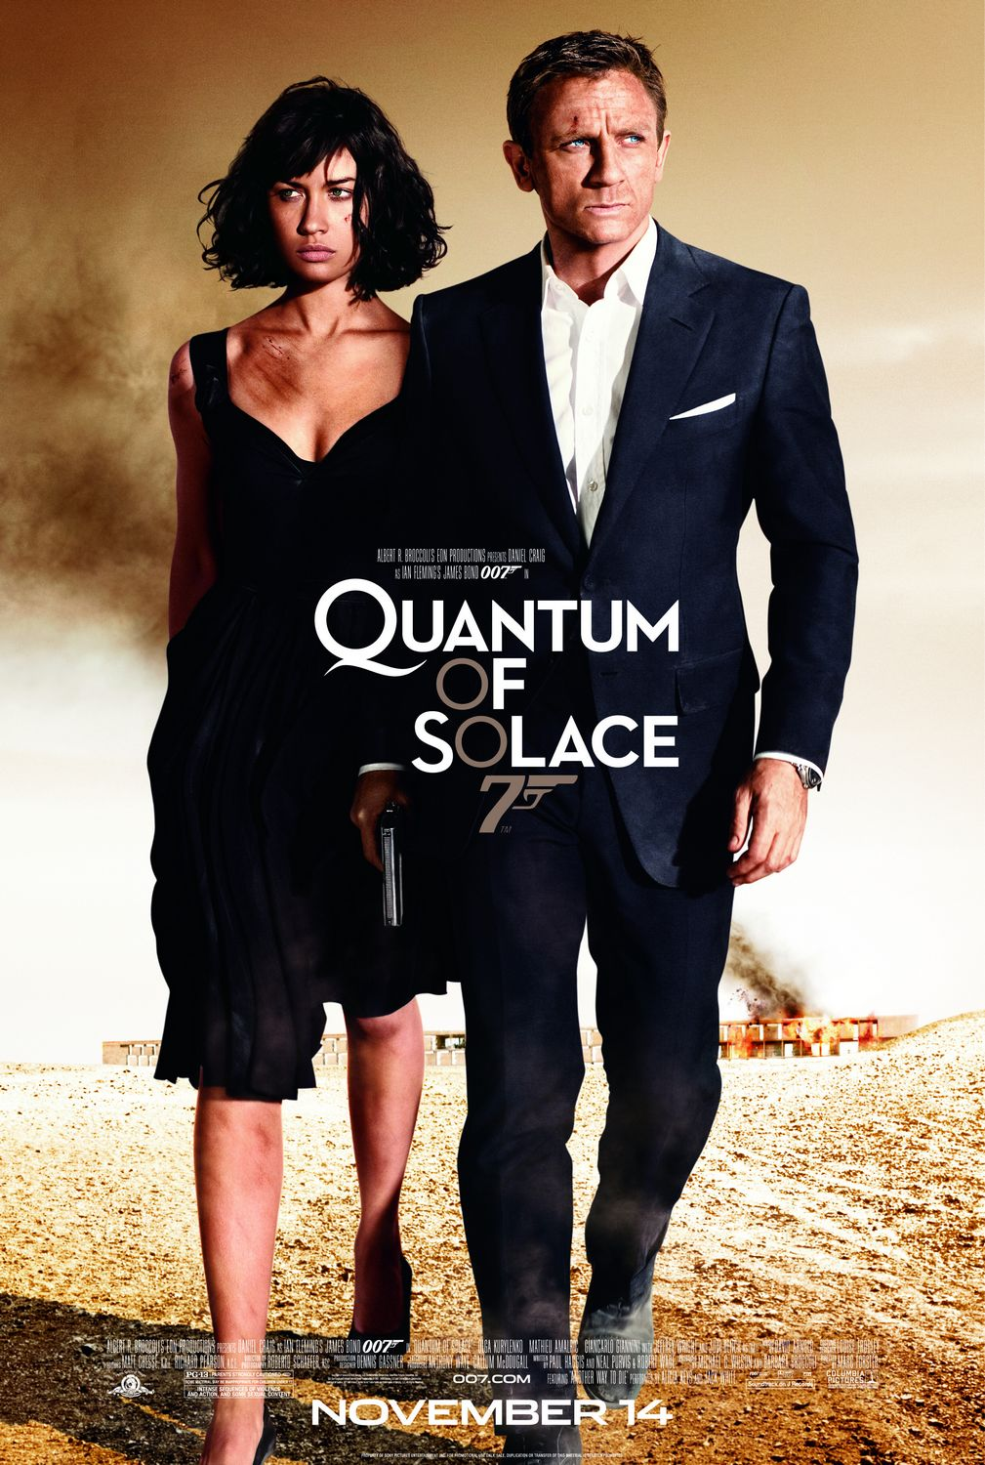

Quantum Of Solace
Link to video
The font is a formal straight font that represents the formality of the film as it is a spy genre.
The colour throughout has an orange blue tint, Using two colours allows it to transition from one to part to another easily just through the change of the colour.
The camera continuously flows making it look faster and more action packed as it flows onto a piece of action most of the time.
Transitions rely on the colour a lot of the time and follows bullets showing that during the film it would include guns and fighting.
Special effects and CGI are used to make people and things into silhouettes so you do not know who is the villain and who is the hero therefore not spoiling the film and also adding mystery
The non diegetic accompanying music is loud and intense giving us an idea of what it will be like as this is part of the soundtrack. It includes the electric guitar a lot which adds the effect of including action.

Slide 5
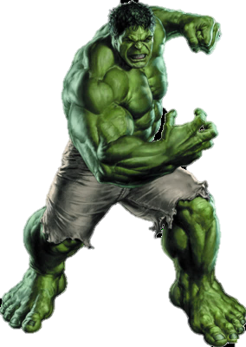
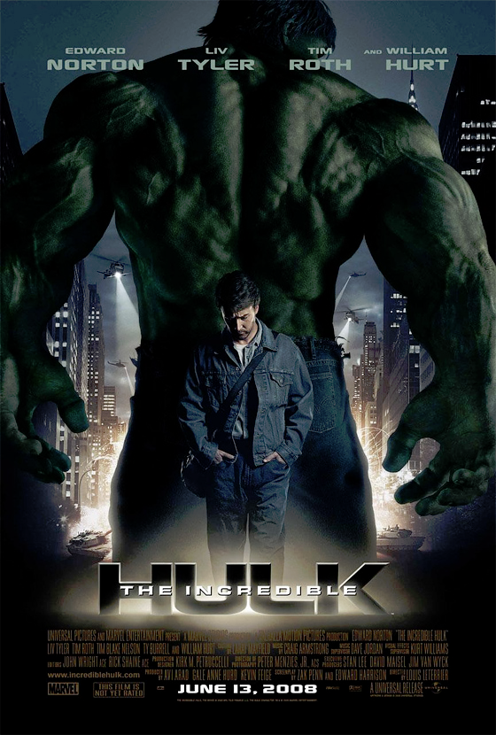
The Incredible Hulk
(2008)
Link to video
The main title saying ‘The Incredible Hulk’ has the
‘Hulk’ part as a much bulkier part from the others, this
representing the character hulk in the film.
The colour of every title is green as this is the house style because of the colour of hulk
There are point of view shots with him as The Hulk as this gives us the idea of what its like for him; how it is different from being a human and what its like to be superhuman
There is the mise en scene lab coats during the start showing us that it is to do with science and the green suggests radioactivity and therefore we can infer it is to do with science and radioactivity. Also there is the costume of the military uniforms which have connotations of war.
There is a part where the camera zooms on a sign saying danger and as it zooms more and more it then quickly cuts to an extreme close up of the characters unnaturally green eyes conveying something has gone dangerously wrong.
The non diegetic accompanying music is fast paced and intense and builds up to the action part of the sequence, I’ve found that this is effective and it is an idea for music in my sequence.

Slide 6
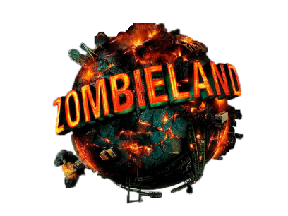
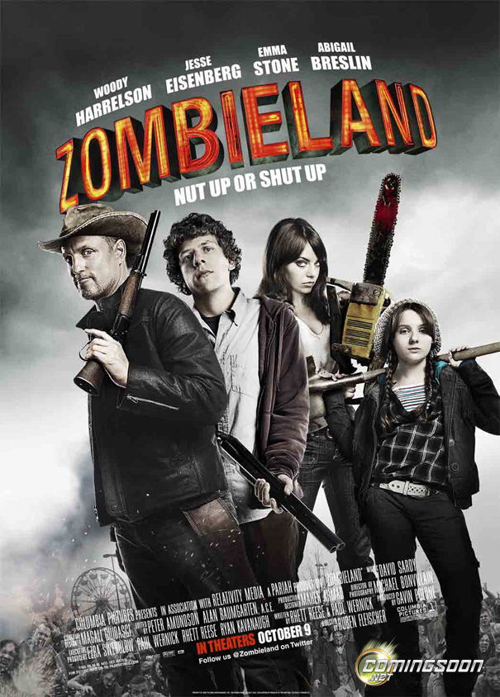
ZombieLand
Link to video
The non diegetic music is of the rock genre of music
which can have connotations of aggressiveness and violence causing the audience to see the genre as action.
The colour red and orange are used on the titles as the connotations of them two colours together are explosions and destruction.
There is CGI used on the titles to make them interact with the camera e.g. when the man smashes the ‘Zombieland’ title, this makes the opening sequence look more visually appealing to the audience.
The are also special effects to create the slow motion effect, the slow motion emphasises the action sequences that are occurring so you can see all the detail.
There are mid shots and long shots of the humans running and the zombies to show us the fear in their whole body language.
The mise en scene is used with costumes to show all the different situations people were in when the invasion happened which also creates a comedic effect because people were at things such as weddings and this creates schadenfreude. Also a lot of make up was used to create the blood effects. Finally, there are the props of guns, riot shields and crowbars being used for weapons adding more violence.
Each shot fades into the next which is a common transition in films however one is used where a character smashes, what seems like the screen, then that leads to the next shot which creates an effect of destruction in the film.

