Slide 1
Opening Sequences Analyses 11-15
George Nutt
Deconstructing film opening sequences

Slide 2
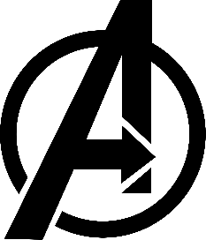
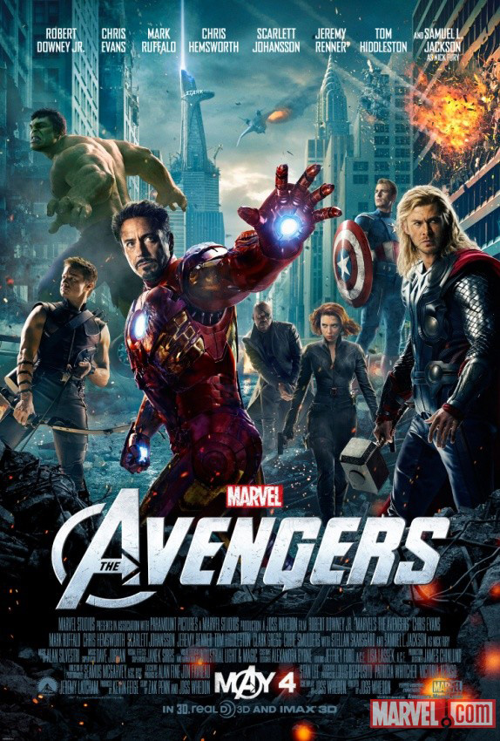
The Avengers
Link to video
The colour is dark apart from the colours of the superheroes costumes which are all emphasised by being bright compared to the dark background.
The font is metallic and silver emphasising the armour, suits and shields. Also the props behind the titles are in focus then it switches to the titles being in focus meaning that we have our focus on both things.
The transition slowly focuses on certain objects that they want to emphasise such as iron mans suit and then it focuses on to the title making sure that both are seen.
The movement is continuous and fast giving us an idea of the movement and flow of the film.
The non diegetic music starts off slow and begins to build up and then when it gets towards the end it transitions into the typical heroic music which is also the signature music to the Avengers franchise and is used for every Avengers film.
The titles are positioned next to the object that matches the actors character’s object which could be an idea for my opening sequence.
Special effects are used to create a 3D effect with the titles making it look visually appealing and also making it look like it is in the film.

Slide 3
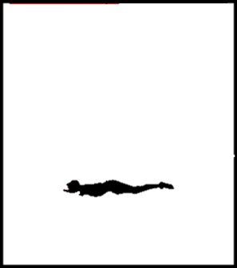
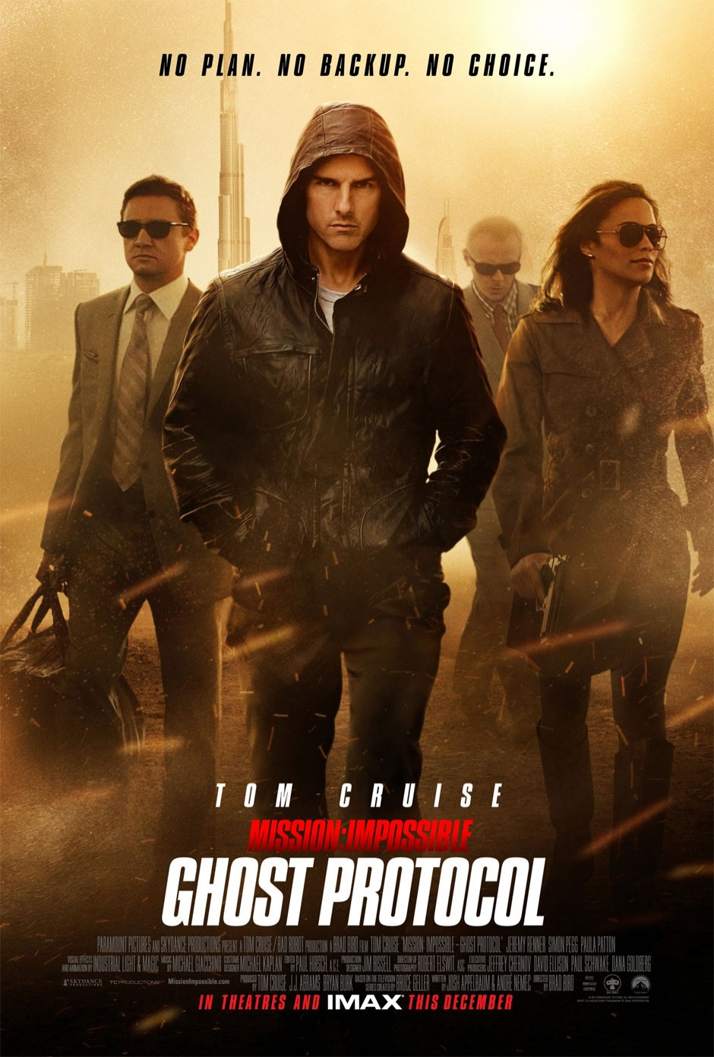
Mission Impossible: Ghost Protocol
Link to video
The colour is dark mostly and is lit up by the fuse going through showing how it makes things less dull as it comes through possibly representing the main protagonist.
The font, when displaying the title ‘Mission Impossible’ has a glow in the style of a fuse then ‘Ghost Protocol’ has a ghostly outer effect ton it.
The style is fast paced and shows a lot of action throughout the journey it goes on representing the locations and sequences that would happen in the film.
The transition is following the fuse all the way through different locations which is a good way of showing the overall possible plot of the film without people realising.
The special effects used were on most things including the fuse, as it would be hard for them to actually do that.
The non diegetic music is tense and follows thestyle of all the other mission impossible so therefore they have become a recognised franchise just from their soundtrack and music throughout all of their films
There is mise en scene used so that they use a lot of guns for props which shows that is an action genre as it will involve guns and violence. Also the costume used for the main character is a vest top to show his body and face clearly as he is the main protagonist meaning he would stereotypically be a white good looking athletic male which he is.

Slide 4
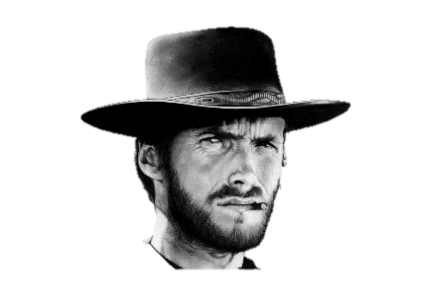
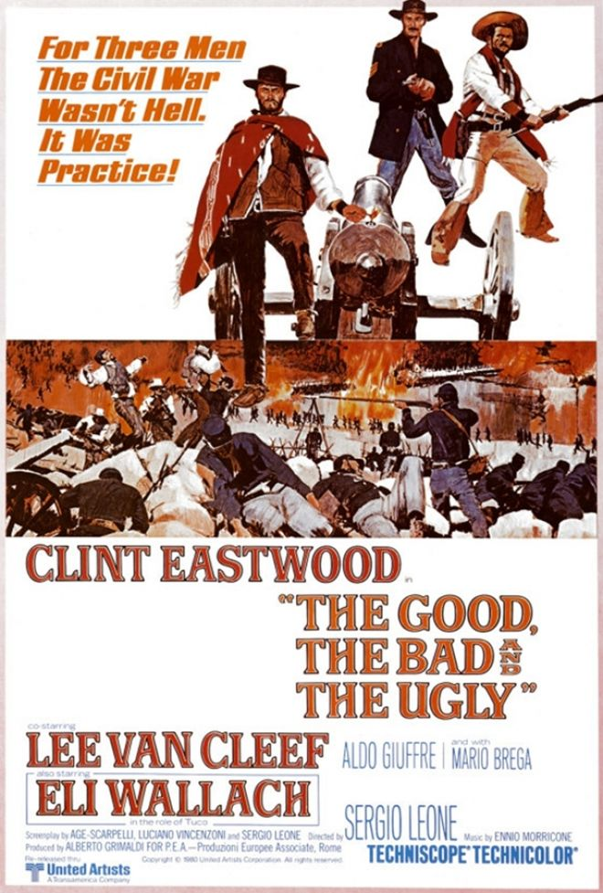
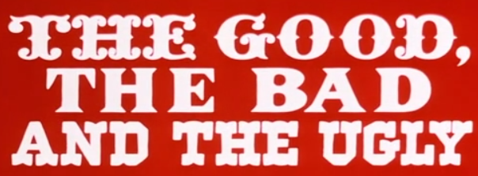
The Good, The Bad and The Ugly
Link to video
The font is a serif, western style, font as it has the tails coming off of each letter, it also changes within the title as ‘the good’ has fancy extra parts on each letter, ‘the bad’ is straight and boring and ‘the ugly’ is a combination with the straight letters but with a few additions. This helps us with ours as we could do separate fonts if we had a long title.
The non diegetic accompanying music is very popular
as it perfectly fits in with the genre of music due to
the instruments, also the diegetic gunshots help it
fit the genre.
The style is a clear wild western style as it includes shots of old canons, stagecoaches people riding horses and the mise en scene of the costumes are old and western. Also the sound of gunshots make it clear it is action based.
The colours are bold and mainly red as this colour
is often used to represent the wild western genre of film.
Some transitions that are used are guns being shot onto the screen then this creating a background for the font, also a liquid spilling onto a surface being used as a background for the font, finally there are grainy transitions at time put there on purpose to make it seem older-looking. I feel these are also good examples of editing and CGI I could use in my title sequence.

Slide 5
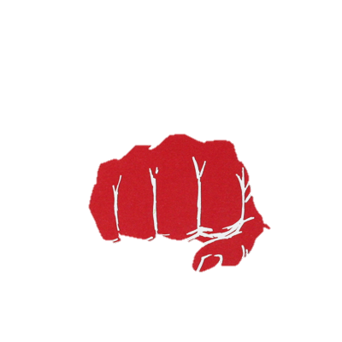
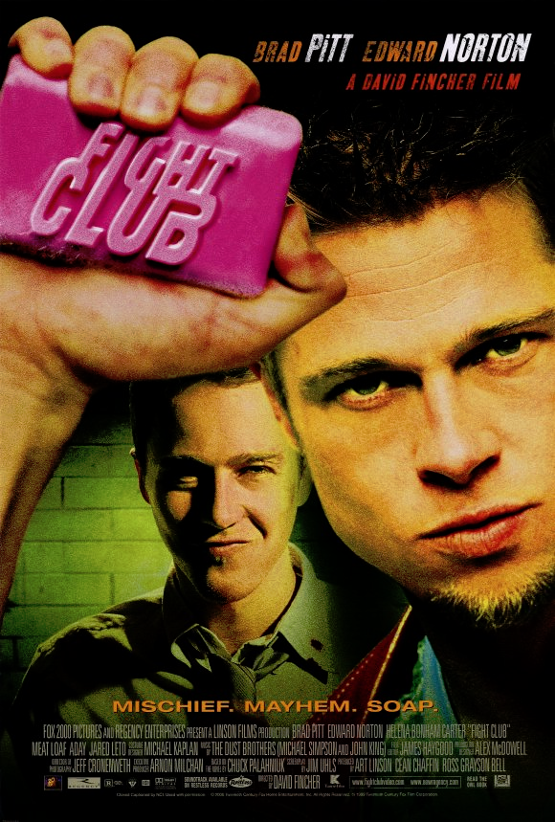
Fight Club
Link to video
Starts with fast paced non diegetic music straight away
Throughout the whole sequence, the titles have a light blue glow on it and there is also a blue tint to everything, possibly showing the going blood through veins which is different as the colour linked with blood most of the time is red.
The movement continuously flows and it slowly zooms further and further out.
The titles are in the centre of the screen as there isn’t much to show in the background so it isn’t covering anything important.
The diegetic sound is almost silent as it shows the production company to emphasise it and put all the focus on it, also the logo is just an ‘R’ showing that ours can be simple.
There is CGI used to create the blue flashing effect and also most of the sequence in general as it would be impossible to physically film this.
At the end when there is an extreme close up (ECU) of the mans face and the camera follows the top of the gun. The ECU shows us the sweat on his head and the connotations of sweat are nervousness , stress and tension.
Then the camera zooms out to a close up with the gun on his face showing his nervous expression and this give us a good first impression on the film which would be that it is dark and probably involves death.

Slide 6

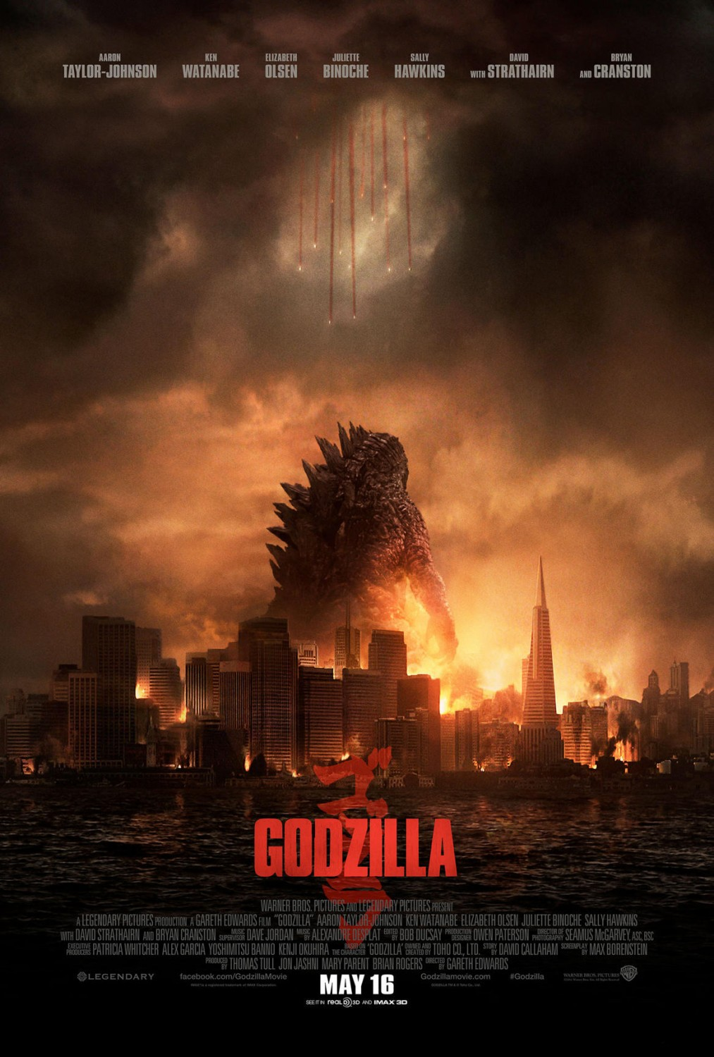
Godzilla
Link to video
The colour is black and white throughout with some very unsaturated colour, this shows us that it could be set in an older era or it is in a poorer country.
The transitions are fast paced cuts showing different glimpses of Godzilla, which could show how it is a myth that people do not have full proof of.
The accompanying music is intense and slowly builds up throughout causing the film to sound intense and like an action film.
The movement is quick and tense throughout and it also has a period feel to it as it shows old camera footage and typewriters.
The titles are like a newspapers article which gives us the effect of old media and the news as Godzilla would be in the newspaper.
The font of the title at the end is damaged looking with a white background to emphasise the explosion that had happened.
The style throughout is clearly old and military it shows military videos in black and white and in de-saturated colour.
There are effects to create an older style as it has videos that look like it is recording an old movie.

